Slide 1
late winter blossoms crow perches on a bare branch nature's calm order

Slide 2
Application Area | Description
Search Optimization | Enables efficient algorithms like binary search.
Data Organization | Critical for databases and file systems, facilitating quick data retrieval.
Algorithm Efficiency | Enhances strategies in divide and conquer algorithms and graph algorithms.
Data Compression | Groups similar data for more effective compression techniques.
Statistical Analysis | Facilitates the calculation of statistics such as medians and quartiles.
Machine Learning | Used in feature scaling and preprocessing for algorithms.
Rendering and Visualization | Essential for graphics rendering and coherent data visualizations.
Scheduling and Resource Allocation | Optimizes job scheduling and task prioritization.
Network Routing | Ensures correct packet sequencing in data transmission.

Slide 3
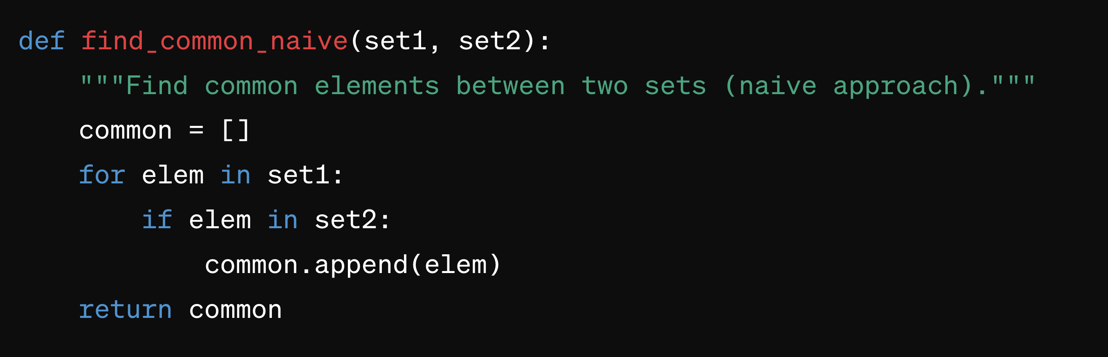
Problem: Find common elements between two sets of numbers
Example Input
set1 set2
{1, 3, 5, 7, 9} {1, 2, 3, 4, 5}
Output:
{1, 3, 5}

Slide 4
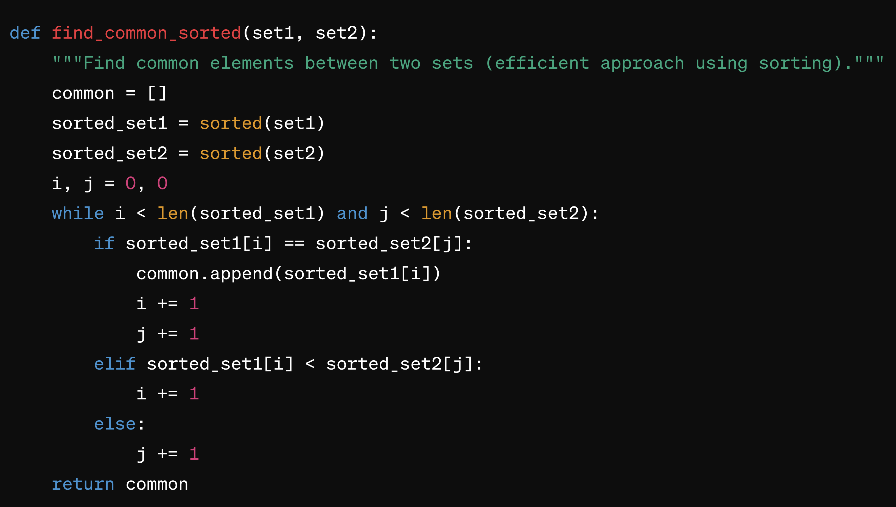

Slide 5
A permutation of a set is any rearrangement of its members into a sequence or linear order.
For a set of n elements, there are n! (factorial of n) possible permutations.
For example, the set {1, 2, 3} has 3! = 6 permutations:
123, 132, 213, 231, 312, 321
Notes:
The factorial complexity (�!n!) arises from considering every possible permutation of �n items to find the one that is correctly sorted. For even modest values of �n, �!n! becomes impractically large. For instance, sorting just 10 items would require considering 3,628,800 permutations, a number that grows exponentially with each additional item.

Slide 6
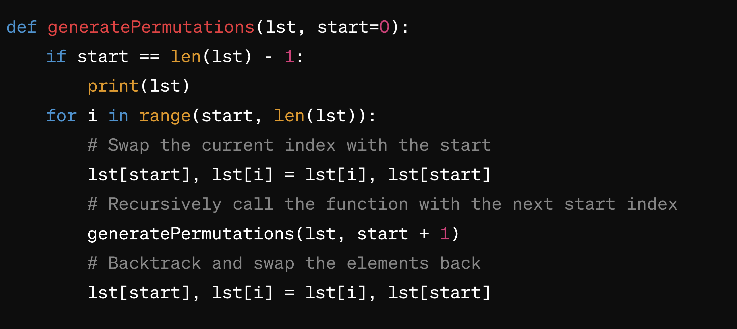

Slide 7
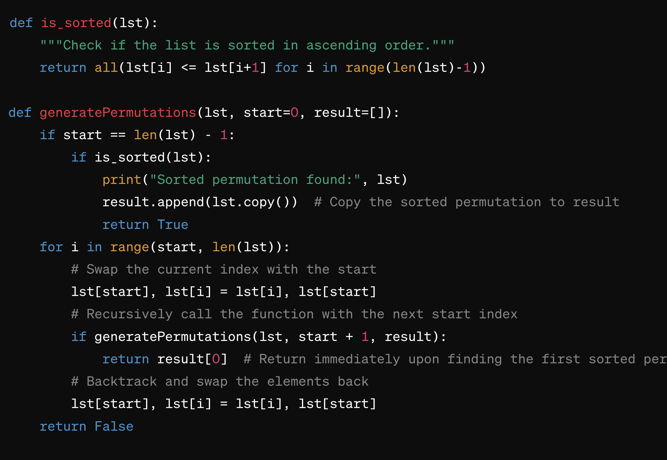

Slide 8
[Nietzsche, Weil, Kant, Foucault, Wittgenstein, de Beauvoir, Plato, Sartre, Arendt, Lao Tzu]
[1 april, 2 janurary, 9 december, 14 june, 18 october]
[Star Wars, Star Trek, Dune, Blade Runner]

Slide 9
Sorting can be broadly defined as the process of arranging items in a systematic sequence (ascending or descending) based on some comparative criteria.
The efficiency of a sorting algorithm largely depends on how it compares elements and rearranges them into the correct order.

Slide 10
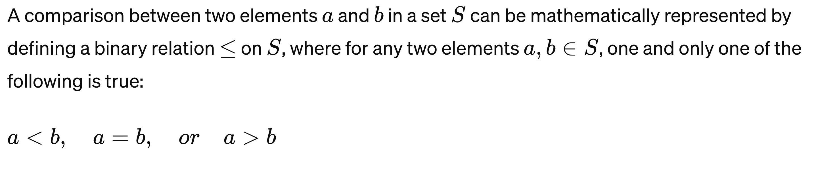
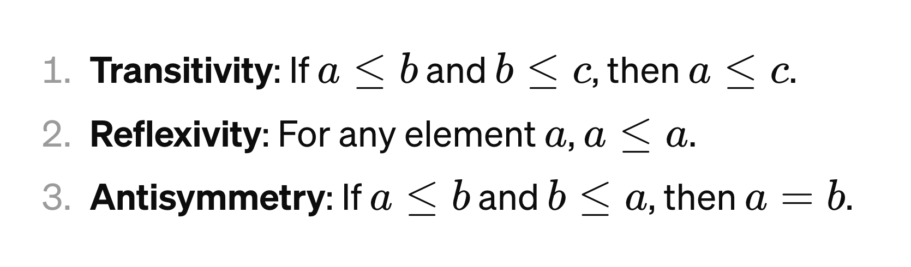

Slide 11
Exploitable Properties
Transitivity of Order: If element A is less than element B, and B is less than C, then A is less than C. Efficient sorting algorithms rely on this property to reduce the number of comparisons needed to determine order across a set.
Stability: The concept that equal elements retain their relative order before and after sorting. Some algorithms maintain stability by carefully managing how elements are moved. This property is particularly important when the sort order depends on multiple fields.
Existence of Natural Runs: In real-world data, sequences of elements are often already in order or nearly in order. Adaptive sorting algorithms take advantage of these "runs" to minimize work, adjusting their approach based on the degree of existing order.
Existence of Identifiable Substructures: Many sorting problems contain inherent substructures that can be isolated and addressed independently before integrating them into a larger solution. For example, divide and conquer algorithms break the problem into smaller, more manageable chunks (subarrays) that are easier to sort.
Distribution of Input: Algorithms like Counting Sort and Radix Sort exploit specific characteristics of the input distribution, such as the range of numerical values or the length of strings, to organize data more efficiently than comparison-based methods.
Relative Ordering (Binary Relations): Sorting fundamentally relies on the ability to determine a binary relation (e.g., less than, greater than) between any two elements. Efficient algorithms optimize how many and which comparisons are made to determine the overall order with fewer operations.
Element Uniqueness and Repetition: Some sorting algorithms are particularly well-suited to handling data with many repeated values (e.g., counting sort) or ensure unique outcomes by managing how duplicate values are treated.

Slide 12
Divide and Conquer: Exploits substructure by breaking the problem down and solving smaller problems independently.
Hybrid Approaches: Use the stability and natural runs properties to combine sorting methods for optimal performance on varied data.
Adaptive Sorting: Adjusts algorithmic behavior in real-time based on the degree of existing order, leveraging natural runs.
Counting and Positioning: Utilize the distribution of input and relative ordering properties to sort without direct element-to-element comparisons.

Slide 13
Property | Algorithms | Description
Transitivity of Order | All comparison-based sorts (e.g., Bubble, Quick, Merge) | These algorithms rely on the transitive nature of the comparison to sort the entire dataset by comparing pairs of elements.
Identifiable Substructures | MergeSort, QuickSort | Divide and conquer algorithms break the dataset into smaller pieces, sort those pieces, and then combine them, exploiting the problem's substructures.
Stability | MergeSort, Bubble Sort, Insertion Sort | These algorithms maintain the relative order of equal elements, making them suitable for multi-field sorting.
Natural Runs | Timsort, Insertion Sort | These adaptive algorithms exploit existing order within the dataset to reduce the number of operations required.
Distribution of Input | Counting Sort, Radix Sort, Bucket Sort | These non-comparison sorts organize data based on the distribution of input values, often leading to linear time sorting under certain conditions.
Relative Ordering | All comparison-based sorts | Fundamental to comparison-based sorting, this property is directly used to determine the sorted order through element comparisons.
Element Uniqueness and Repetition | Counting Sort, Radix Sort | Efficient in handling datasets with many repeated values by organizing elements based on their counts or digit/character positions.

Slide 14
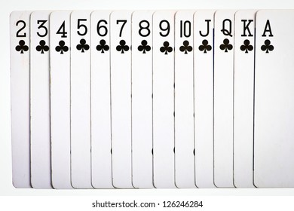

Slide 15
https://visualgo.net/en/sorting

Slide 16
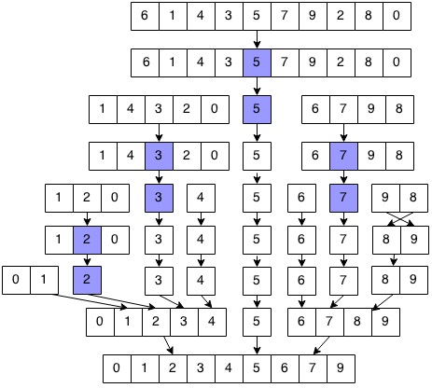
Quick Sort

Slide 17
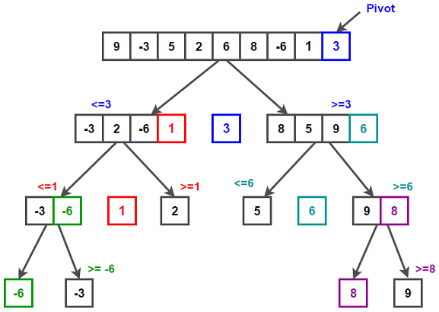

Slide 18
Quick Sort - Pivot

Slide 19
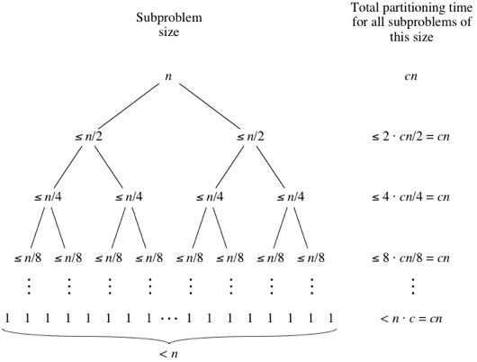
Quick Sort Complexity (best case)

Slide 20
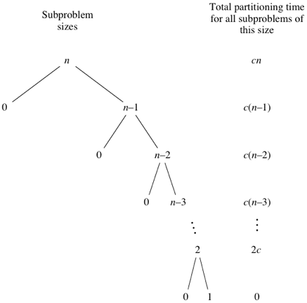
QuickSort Complexity (worst case)

Slide 21
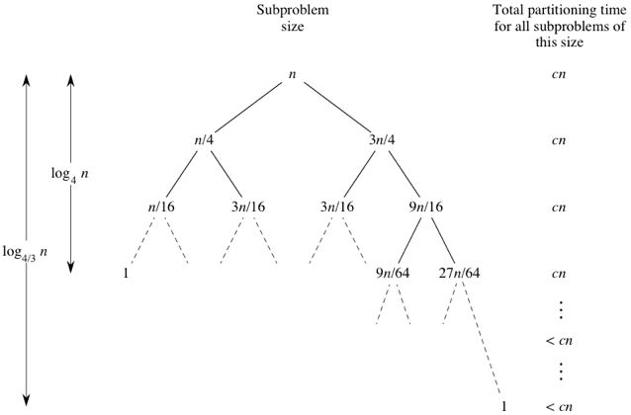
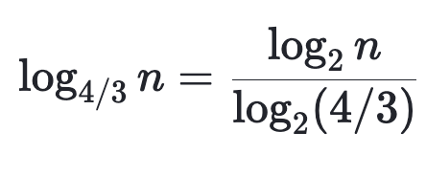
QuickSort Complexity (‘example’ case)
(4/3)^{x} = n for which x?
answer:
log_{4/3}​n
and:
log_{b}(x) = log_{c}(x) / log_{c}(b)
thus:

Slide 22
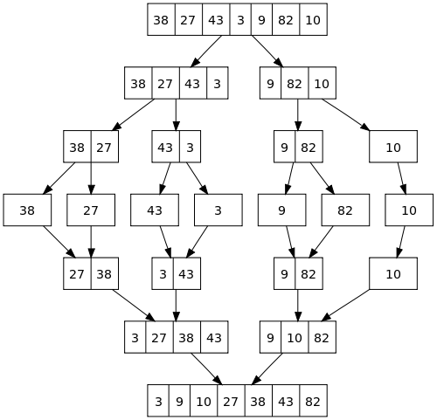
Merge Sort

Slide 23
Merge Sort - Merging

Slide 24
Merge Sort - Merging
Notes:
Complexity!

Slide 25
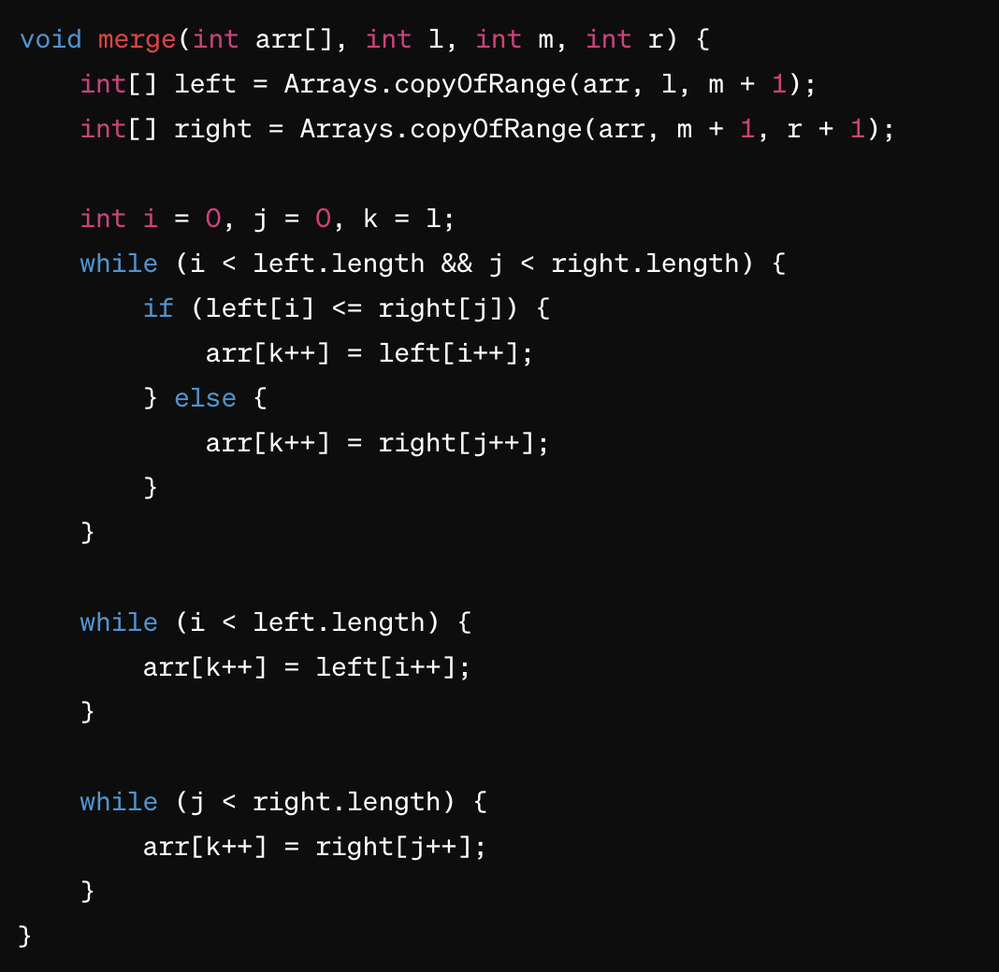
Notes:
Complexity O(n)
Space O(n)

Slide 26
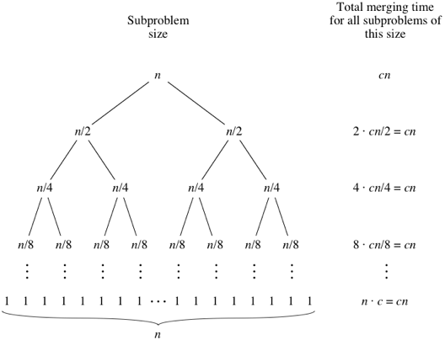
Merge Sort Complexity

Slide 27
https://www.youtube.com/watch?v=dENca26N6V4
https://www.youtube.com/watch?v=3San3uKKHgg

Slide 28
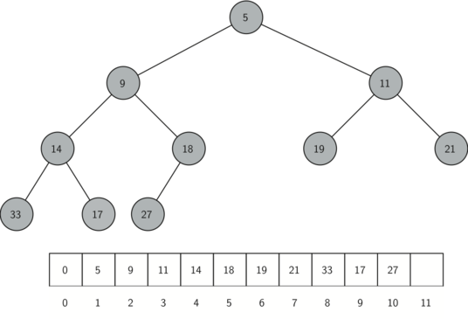
Heap

Slide 29
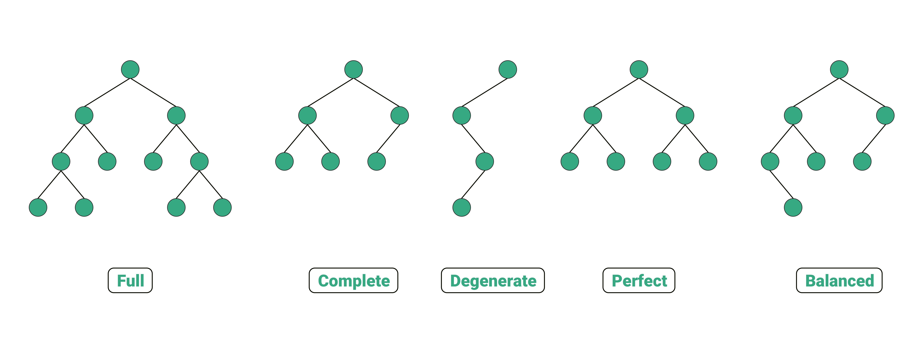
Notes:
The number of nodes, �N, in a perfectly complete binary tree (one that is completely filled, including the last level) of height ℎh can be calculated using the formula: �=20+21+22+...+2ℎ=2ℎ+1−1N=20+21+22+...+2h=2h+1−1
This formula sums the number of nodes at each level. For a heap that is not perfectly complete (i.e., the last level is not fully filled), the minimum number of nodes it could have is 2ℎ2h (since it has at least one node at the height ℎh), and the maximum number of nodes is 2ℎ+1−12h+1−1 (if it were perfectly complete).

Slide 30
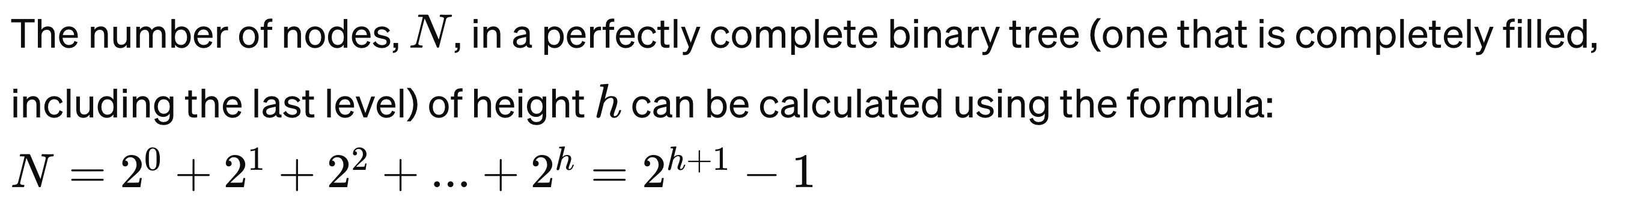
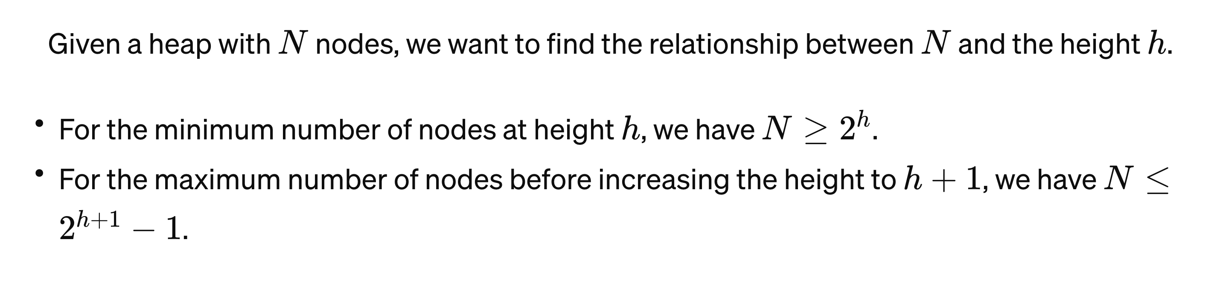
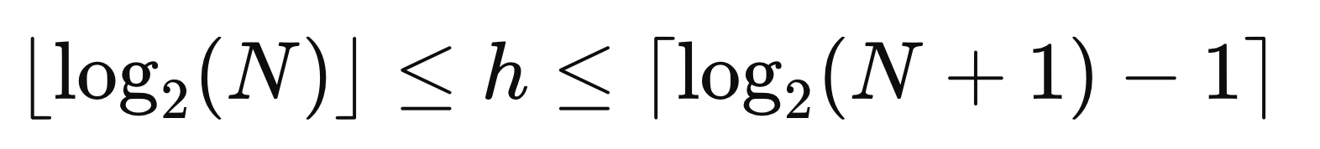
Notes:
This equation sums the nodes at each level of the tree. Here, "-1" adjusts for the fact that the sum of a geometric series (in this case, the sum of nodes at each level of the tree) is actually calculated using the formula �=�(��−1)�−1S=r−1a(rn−1)​, where �=1a=1 (the first term), �=2r=2 (the common ratio), and �=ℎ+1n=h+1 (the number of terms, because we start counting levels from 0 to ℎh). Simplifying this gives us 2ℎ+1−12h+1−1.
Here we can even say that the heap is THETA(log(n)) as it is logarithmically bound from below and above.

Slide 31
Heap Insertion
Step 1 − Create a new node at the end of heap.
Step 2 − Assign new value to the node.
Step 3 − Compare the value of this child node with its parent. Step 4 − If value of parent is less than child, then swap them. Step 5 − Repeat step 3 & 4 until Heap property holds.

Slide 32
Heap Deletion
Step 1 − Remove root node.
Step 2 − Move the last element of last level to root.
Step 3 − Compare the value of this child node with its parent. Step 4 − If value of parent is less than child, then swap them. Step 5 − Repeat step 3 & 4 until Heap property holds.
Swap with its smaller child in a min-heap and its larger child in a max-heap

Slide 33
Lower Bound
function sortArray(arr):
if arr is sorted:
print "Sorted array:", arr
return
for i from 0 to length(arr)-1:
for j from i+1 to length(arr):
if arr[i] > arr[j]:
swap(arr[i], arr[j])
sortArray(arr)
swap(arr[i], arr[j])

Slide 34
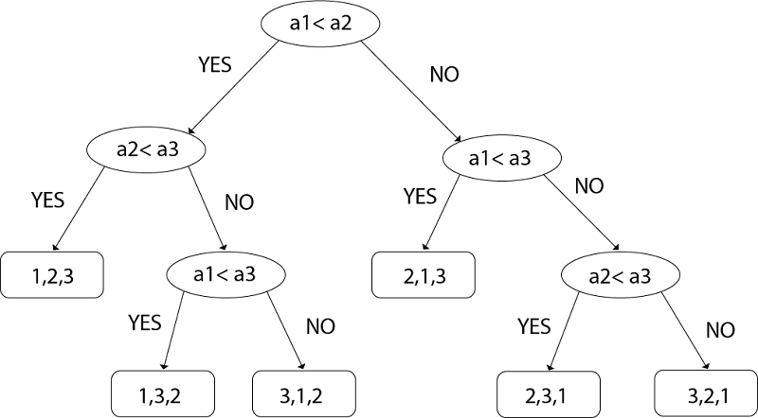

Slide 35
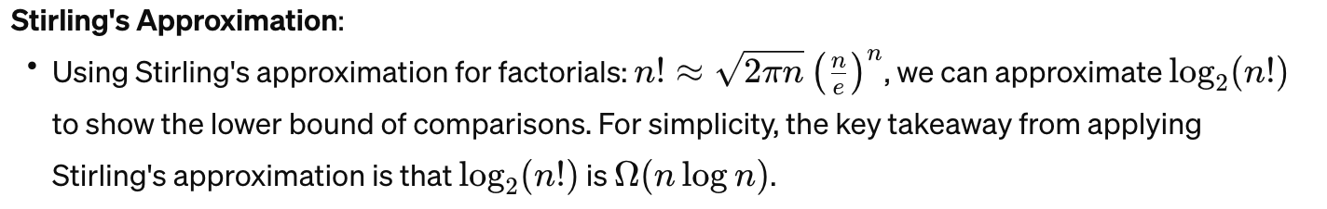
Lower Bound
function sortArray(arr):
if arr is sorted:
print "Sorted array:", arr
return
for i from 0 to length(arr)-1:
for j from i+1 to length(arr):
if arr[i] > arr[j]:
swap(arr[i], arr[j])
sortArray(arr)
swap(arr[i], arr[j])

Slide 36
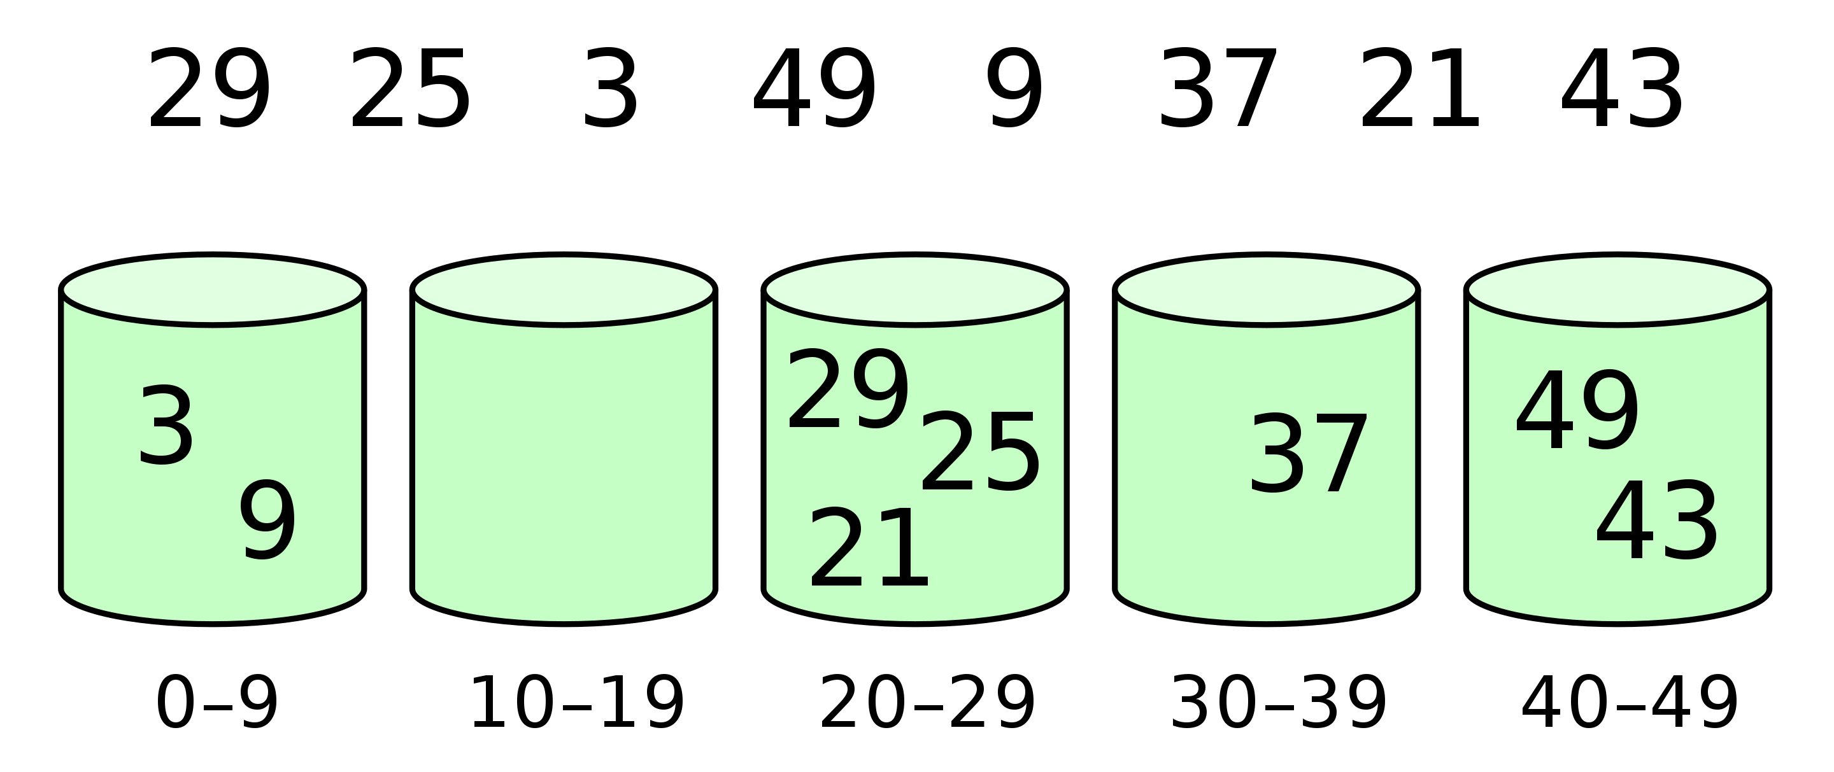
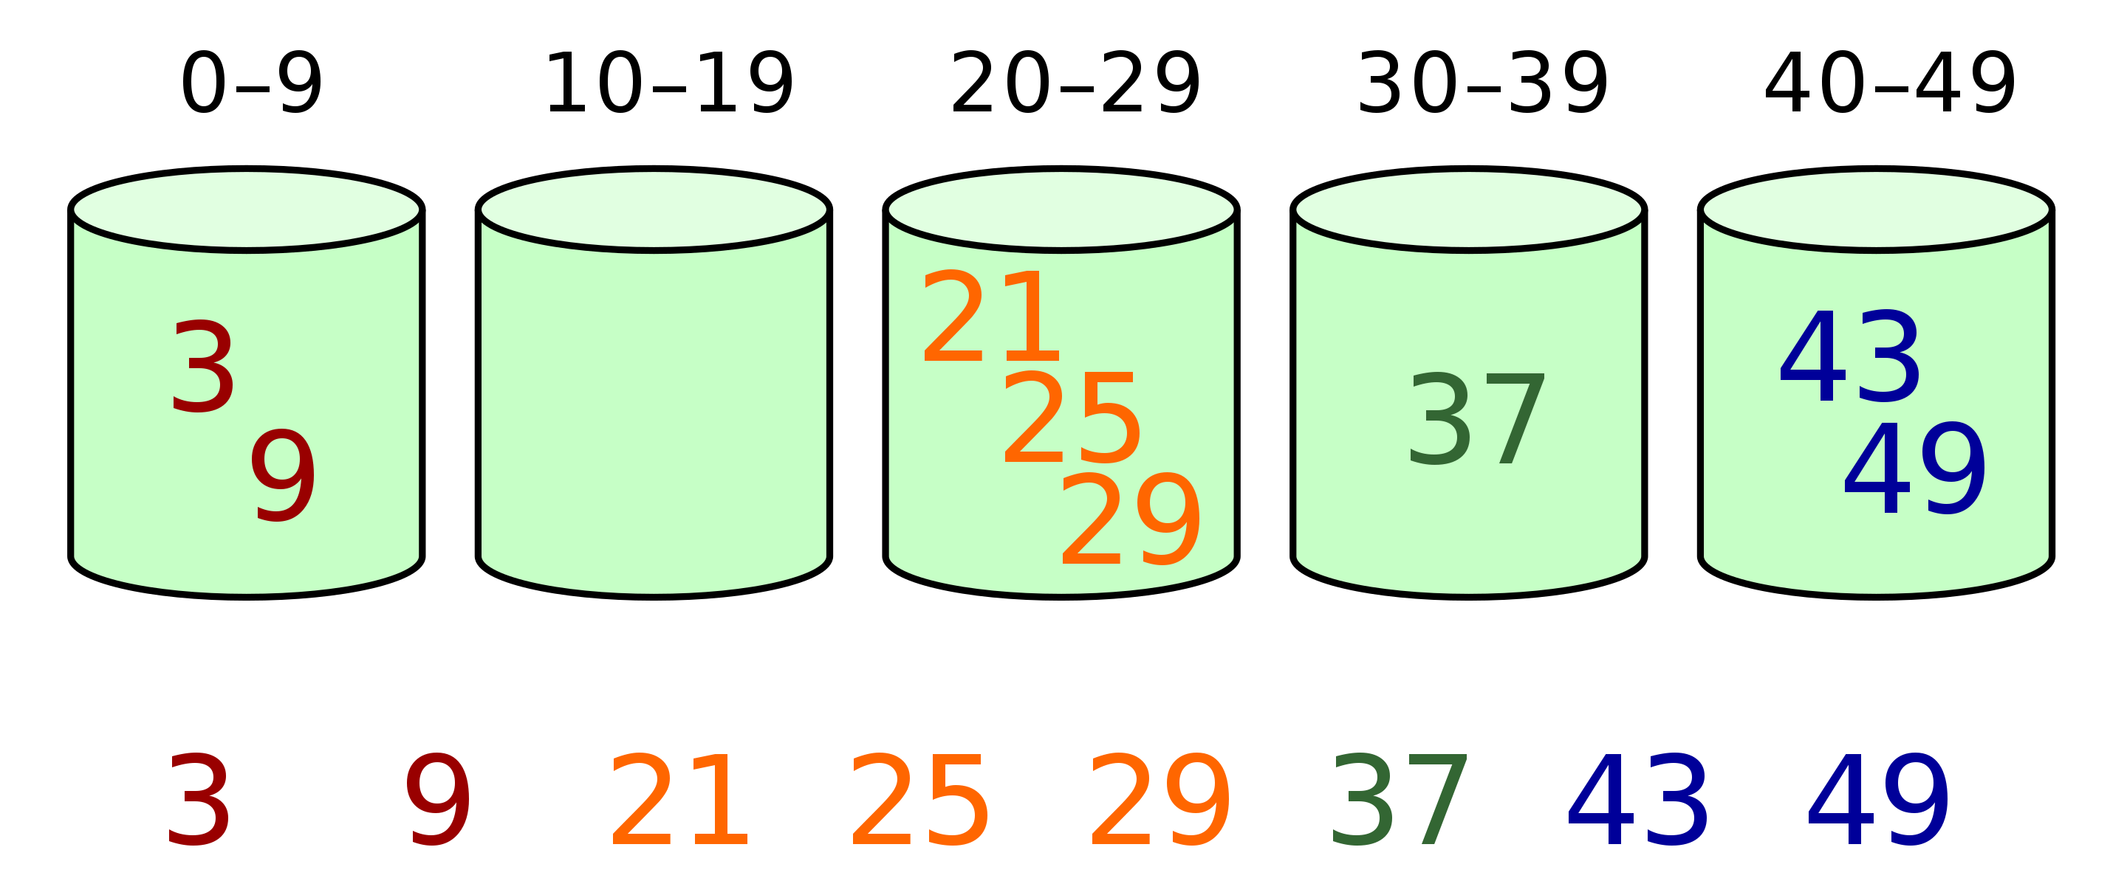
Bucket Sort
function bucketSort(array, bucketSize):
// 1. Create buckets and distribute the elements of the array into buckets
buckets = create array of bucketSize lists
for each element in array:
index = determine the appropriate bucket for element
add element to buckets[index]
// 2. Sort individual buckets
for each bucket in buckets:
sort(bucket) // Use a different sorting algorithm
// 3. Concatenate all buckets back into original array
index = 0
for each bucket in buckets:
for each element in bucket:
array[index++] = element
Notes:
Best and Average Case: O(n+k)
Worst Case: O(n2^)
n: The number of elements in the input array.
k: The number of buckets.
Why O(n+k) and O(n^2)?
In the best and average cases, assuming the elements are uniformly distributed, each bucket gets a small portion of the input array elements. If these buckets are then sorted using an efficient algorithm (or further bucket sort with a good distribution), the overall time can be linear with respect to the number of elements.
The worst-case scenario O(n^2)) occurs when all elements are placed into a single bucket. The efficiency of bucket sort then depends on the sorting algorithm used for sorting individual buckets. If using a quadratic sorting algorithm (like Insertion Sort) for the buckets, and all elements end up in a single bucket, the worst-case time complexity becomes O(n^2).

Slide 37
Counting Sort
Notes:
Best, Average, and Worst Case: O(n+k)
The time complexity of Counting Sort depends on:
n: The number of elements in the input array.
k: The range of the input values (i.e., the difference between the maximum and minimum values).
Same for space complexity

Slide 38
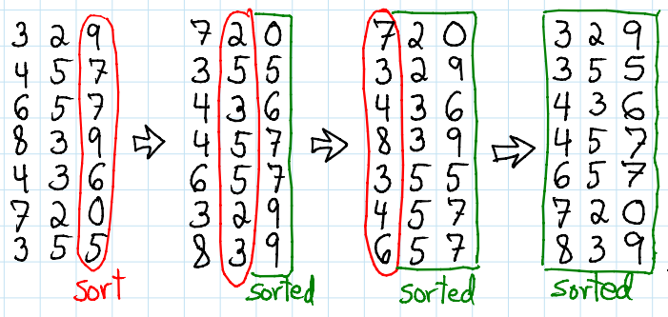
Radix Sort

Slide 39
n: The number of elements in the array.
b: The base of the numbering system. In the case of decimal numbers, b=10.
d: The number of digits in the maximum number in the array, which determines how many passes Radix Sort makes over the data.
Complexity: O(d(n+b))
Notes:
Each of the d passes sorts the array based on a particular digit, from the least significant digit to the most significant digit.
Counting Sort is used for each pass, which has a complexity of O(n+b) because it needs to consider each of the n elements and uses temporary count/storage arrays of size b.
Since you perform d such sorts, the total time complexity is O(d(n+b)).
Space O(n + k)
This accounts for the storage needed for the output array (size n) and the count array (size k).

